Slide 1
OAFC Bible Studies

Slide 2
Step 1: Get Bible
Make sure everyone has a Bible!
Have a good Bible for you.
Different translations are sometimes nice, but can be very confusing when each person has a different translation.
Study Bibles are perfect!

Slide 3
Step 2: Leader and Assistant Seating
Assistant leader should always sit next to the leader. They provide an additional example.
Ladies, that is you!

Slide 4
Step 3: Leader Prayer
Only the leader says this prayer.
Give me an example…
Short and sweet
Usually thanking God for the gift of His Word
Don’t use… “this” or “these.”

Slide 5
Step 4: One-Sentence Thank You Prayer
Explain what this prayer is.
Give an example.
Let everyone know that it doesn’t have to be a fancy prayer.
Assistant helper

Slide 6
Step 5: Find Passage
If you see some struggling to find the passage, give a clue to the location of the book.
Move to next step while others are finishing.

Slide 7
Step 6: Introduce Method
Tell the new members or congregation members what you are going to do.
Read it through once.
Reread it again and then explain it.

Slide 8
Step 7: Bible Study!

Slide 9
Exegesis
Can be used on any passage, not just OAFC
There should never be a verse without discussion.
If you don’t know what a verse is even talking about, break it up according to the commas.
USE YOUR STUDY BIBLE!
Ask a question to the pastor in your group.

Slide 10
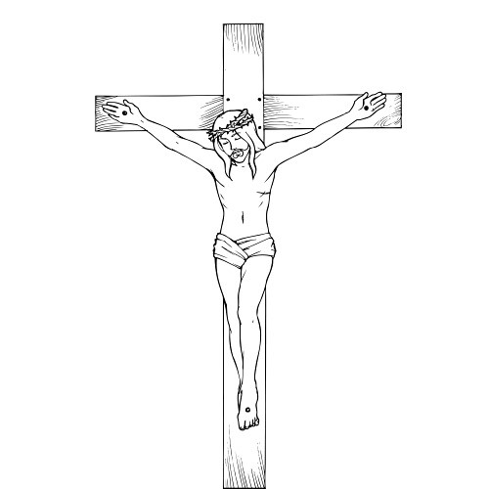
Jesus
The Bible is Christocentric.
Did this verse… talk about Jesus’ coming?
Did this verse… talk about His ministry?
Did this verse… talk about His coming back?

Slide 11
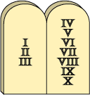
Law
10 Commandments
“Hey, man, they all died.”
Did this verse… remind me of my sins and their consequences?

Slide 12
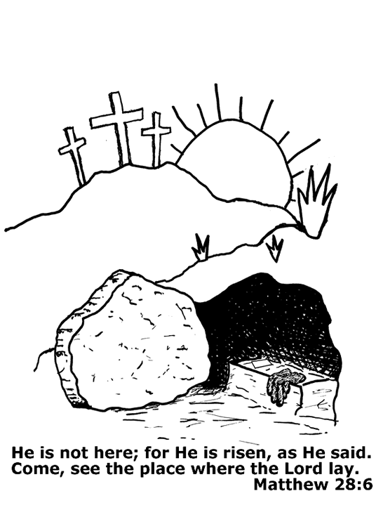
Gospel
Jesus died for our sins!
He is coming.
He is here.
He is coming back.
Did this verse… talk about Christ’s saving work?

Slide 13
Sacraments
They are…?

Slide 14
Baptism
We receive forgiveness and eternal life.
We become a member of God’s Family.
I see water…I think baptism!
Did this verse… talk about water?

Slide 15
Lord’s Supper
We receive forgiveness of sins and eternal life.
Did this verse… talk about eat and/or drink?
Did this verse… talk about wine or blood?
Did this verse… talk about bread or sacrifice of body?

Slide 16
Liturgy
Do we use this in worship?
Do we use this in songs?
Did this verse… remind me of our worship service?

Slide 17
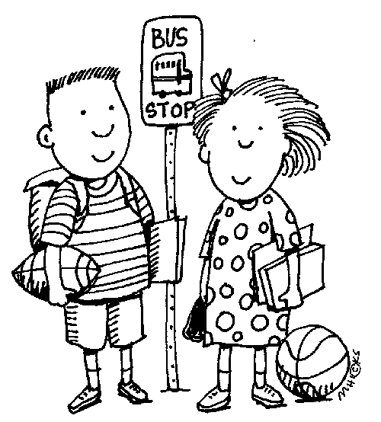
Personal Witness
Think of a time you used this verse.
How would this help you witness?
Did this verse… help you witness your faith?
Did this verse… remind you of the need for witnessing?

Slide 18
Spiritual Life
How does this relate to temptation?
How can this help me grow in my faith?
Did this verse… cause me to reflect on my relationship with Christ?

Slide 19
OAFC
We are out there witnessing to others, there should be stories.
Witnessing Methods
Did this verse… talk about witnessing?
Did this verse… talk about others who do not know the Lord?

Slide 20
Step 8: Wrap-UP
Spokesman
Summary
Most interesting thing that you learned.

Slide 21
Step 9: Closing Prayer
Leader again starts, but relating it to the passage just studied.
Armor of God- You arm us Lord with Your Word.
Love is Patient- Thank you for loving us first.
Death of Stephen- We pray that our witness might be so strong.
Assistant prays next.
Everyone else prays after. Leader closes.

Slide 22
Step 10: Go Back
Go Back to the Circle
Don’t interfere with the other group.
If you have to stall for time, TALK ABOUT OAFC. THAT IS WHY YOU ARE THERE!
Don’t be late! Hosts are waiting or the canvass is ready.

Slide 23
P.S.
This will make any other Bible study boring.
Advanced level of faith
This will make your Bible studies with OAFC way more interesting.

